Slide 1
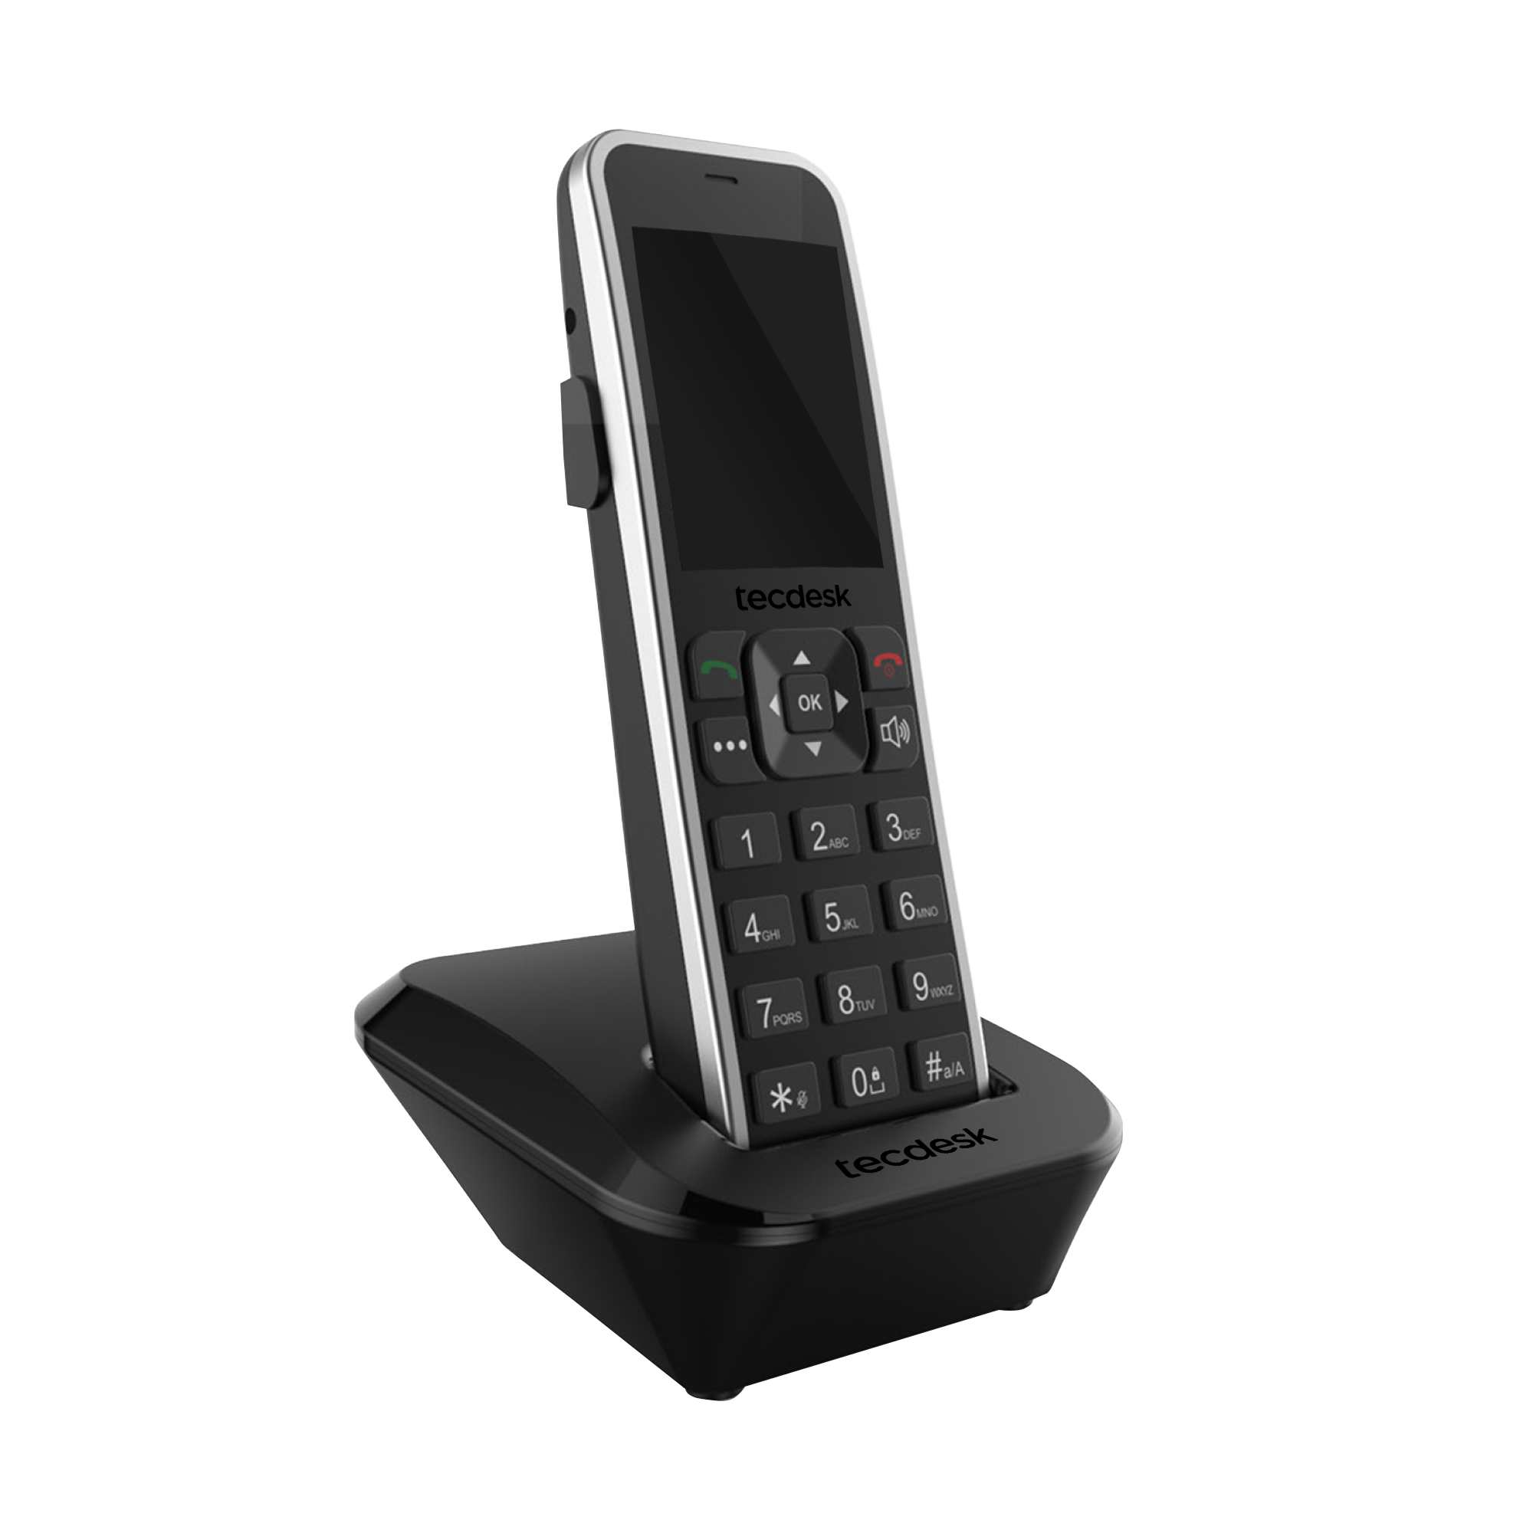
Model 5
Bringing simplicity, Android tech and Portability to your home
and office. With the portable belt clip, you’ll never miss that
important call ever again.
Portable
Belt Clip
Screen | 2.4” Colour Screen (240px * 320px)
SIM Card | Standard SIM Card
Frequency | 2G, 3G, 4G LTE / VoLTE
Voice | HD Voice & Noise Cancellation
Headset | Supports 3.5mm Headsets
Connectivity | Wi-Fi Hot Spot, Bluetooth v4.2, GPRS, Edge, SMS Messaging
Virtual PBX Functions* | ​Call Forward, Waiting, Transfer, Conference, Hunt Groups + More
Handset Features | Call Mute, Loud Speaker, Menu, Volume & Navigation Keys, 3.5mm Jack, Portable Belt Clip
Stand | Charging Dock
Multi Line | AT Hayes Command Set Support for IP Centrix systems
Language | Multi Language Support
Processor | Spreadtrum 9820E, Cortex-A53
Operating System | Android, enabling smartphone features at your desk
Power | Battery & Type C USB Power Cord for indefinite power on
Dimensions | Model 5: 160 * 51 * 21mm, Base: 106 * 93.2 * 46.5mm
Ideal Clientele | B2B SOHOs and SMEs in the private & public sector
For more info, visit tecdesk.com
*Virtual PBX Functions are dependant on the Mobile Network Operator

Slide 2
Model 5 - Specifications
General
Frequency 2G GSM 900/1800MHz
3G UMTS 900/ 2100MHz
4G LTE - TDD 2300/2500/2600
LTE - FDD 800/850/900/1800/2100
Language Supports multiple languages
Battery Type Li-Ion
Battery Capability 1000mAh
Bluetooth Yes V4.2
Dimensions 160*51*21mm
Talk Time 3hrs
Standby Time 72hrs
Charge Time <6hrs
SIM Card 4G Standard SIM
Operating System Android 4.4
Software Platform Android
Hardware Platform Spreadtrum 9820E
Display
LCD Colour Colour 262K
Material TFT
Resolution 240*320
Dimension 2.4”
Power On/Off Animation Yes
Network Display Yes
Wallpaper Yes
Keypad
0-9 * # Yes
Power Buttons Yes
Call Button Yes
Cancel Button Yes
Mute Button Yes
Handsfree Button -
Last Number Redial Buttons -
Navigation Button Yes
Function Button Yes
Call
Call History Yes
Speed Dial Yes
Fixed Dial -
Hot Dial - FDN -
ECT Yes
DTMF Yes
Auto Redial -
Voice-Mail Yes
Conference Call Yes
USSD Yes
Call Forward Yes
Audio
Speaker Yes
Midi Ring Yes
Headset 3.5mm Jack/ Bluetooth
EHS Compatible -
Keypad Sound Yes
Voice Channel Switch Receiver & Handsfree
Power On/Off Audio -
Volume Level 1 - 6
Security
SIM Lock -
Phone Lock -
Network Lock -
Power ON Code Yes
Special SIM Support -
PIN Lock Yes
Security Configuration Yes
Data/Connectivity
GPRS Yes
EDGE Yes
SAT -
USB Modem Yes
PC Sync -
IP Centrex -
Bluetooth V4.2
Bluetooth Headset compatibility Yes
Tool
Calculator Yes
Alarm Yes
Calendar Yes
Input/Message
Input Switch #
Symbol Switch *
SMS Yes
Phonebook
Caller ID Display Yes
Capacity -
Copy Yes
Group Yes
Contact Editing Yes
Accessories
Data and Charging Cable Yes
User Manual Yes
Charger 2Pin
3Pin (optional)
Charger
Charger Type DC
Input AC 100 - 240V
50/60Hz
Output 5.0V / 1A
Approved Standard
CE Yes
RoHS Yes
*Virtual PBX Functions are dependant on the Mobile Network Operator

